Slide 1

Iot Project
Abdullah Tahir
Raees Ul Mujtaba
Talha Mehmood

Slide 2
Introduction
Title: Smart IoT Power & Environment Monitor Subtitle: A Real-Time Remote Monitoring System using ESP32, FastAPI, and React

Slide 3

Introduction
Title: Project Overview
What is it? An Internet of Things (IoT) system that monitors electrical power and room environment in real-time.
Key Features:
  Measures Voltage, Current, and Power consumption.
  Monitors Temperature and Humidity.
  Wireless data transmission over Wi-Fi.
  Web-based Dashboard for remote viewing.
Goal: To create a low-cost, scalable system for monitoring DC loads and environmental conditions remotely.

Slide 4
Problem Statement
Title: Why Build This?
The Problem:
  Monitoring power consumption of devices usually requires manual tools (multimeters).
  Physical presence is needed to check device status (Is the fan running? Is it overheating?).
  No historical data log to analyze trends over time.
The Need: A system that automates this process and makes data accessible from anywhere on a laptop or phone.

Slide 5
System Architecture
Title: How the System Connects
The 4 Pillars:
Hardware (Edge): ESP32 + Sensors (INA219, DHT11).
Communication: Wi-Fi (HTTP POST Requests).
Backend (Server): Python (FastAPI) + Supabase (Database).
Frontend (User): React.js Dashboard.

Slide 6
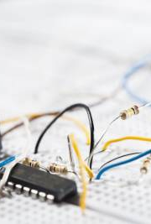
Hardware Components
Title: Hardware Used
Microcontroller: ESP32 (Dual-core, Integrated Wi-Fi).
Power Sensor: INA219 (Measures Voltage up to 26V and Current).
Environment Sensor: DHT11 (Temperature & Humidity).
Power Supply: 9V Battery with LM2596 Buck Converter (Stepped down to 5V).
Load: 5V DC Fan and LED.

Slide 7
Circuit Design
Title: Circuit & Wiring
Power Logic:
LM2596 regulates 9V battery $\rightarrow$ 5V for the Fan.
INA219 sensor is placed in series with the Fan ("High-Side" measurement).
Pin Mapping:
I2C (INA219): SDA $\rightarrow$ GPIO 21, SCL $\rightarrow$ GPIO 22.
DHT11: Data $\rightarrow$ GPIO 18.
Power: ESP32 powered via USB for stability; Fan powered via Battery.

Slide 8
Software Stack
Title: Technologies Used
Firmware (ESP32):
  Written in C++ (Arduino IDE/PlatformIO).
  Libraries: Adafruit_INA219, DHT, HTTPClient.
Backend API:
  Python (FastAPI): High-performance web framework.
  Uvicorn: ASGI Server for handling requests.
Database:
  Supabase (PostgreSQL): Cloud database for storing sensor logs.
Frontend:
  React.js (Vite): Fast, modern UI library.
  Recharts: For rendering live data graphs.

Slide 9
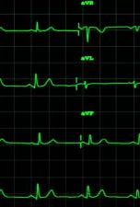
Data Flow Logic
Title: How Data Travels
Sense: ESP32 reads voltage (4.1V) and temp (20°C).
Format: Data is packed into a JSON object.
  {"voltage": 4.1, "temperature": 20.0, ...}
Transmit: ESP32 sends an HTTP POST request to the Python Server IP.
Process: Python verifies data and saves it to Supabase.
Visualize: React Dashboard asks for "Top 10 Newest Records" and updates the charts.

Slide 10
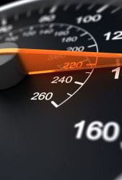
The Dashboard (Result)
Title: User Interface (Frontend)
Real-Time Monitoring:
  Live Charts for Voltage, Current, and Power.
  Gauges for Temperature and Humidity.
Status Indicators:
  Visual text showing if the Fan is ON/OFF.
Auto-Refresh: The interface updates automatically every 2 seconds without reloading the page.

Slide 11
Challenges & Solutions
Title: Challenges Faced
1. The Brownout Issue:
  Problem: 9V battery voltage dropped when Wi-Fi turned on, crashing the ESP32.
  Solution: Separated power sources (USB for ESP32, Battery for Fan).
2. Data Synchronization:
  Problem: Dashboard showed old "ghost" data (12.5V).
  Solution: Updated backend to sort by ID (Descending) instead of timestamp.
3. Network Blocking:
  Problem: ESP32 got "Error -1" (Connection Refused).
  Solution: Configured Server to run on 0.0.0.0 and allowed Python through Windows Firewall.

Slide 12
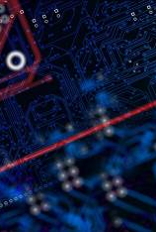
Conclusion
Title: Conclusion
Summary: We successfully built a functional IoT monitoring system that connects hardware signals to a modern web interface.
Key Learning: Integration of Hardware (Electronics) with Software (Full-Stack Web Dev) is critical for IoT.
Status: The system is operational, showing live, accurate data.
Thank You! Any Questions?

